Slide 1
Data Science
Unit-IV
Nonlinear boundaries, Kernel functions
Source: Web resources

Slide 2
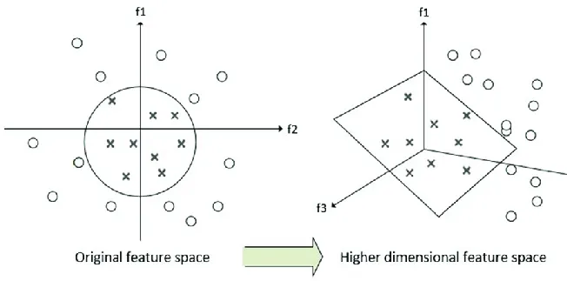
Nonlinear boundaries : Introduction
If the decision boundary cannot be described by a linear equation, more complex functions are used. For example, polynomial functions or kernel methods in SVMs can create non-linear decision boundaries.
These methods effectively map the original feature space into a higher-dimensional space where a linear boundary might be sufficient

Slide 3
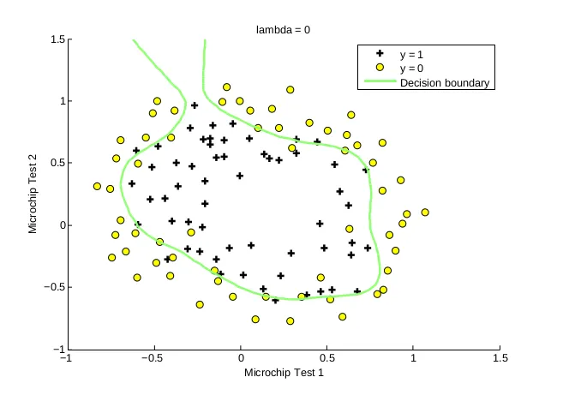
Nonlinear boundaries : Introduction
A non linear decision boundary cannot be separated by a line, plane or a hyperplane. It may have curves, bends or other complex patterns. Models that have non linear decision boundary classification are SVM, Decision Trees and Neural Networks.

Slide 4
Nonlinear boundaries : Introduction
Adding polynomial terms with higher order powers may induce non linearity or curves that may capture the complex relationship well. Models like Decision Trees, Random Forests, and Gradient Boosting can handle non-linear boundaries naturally by splitting the feature space into regions.

Slide 5
Kernel Functions
Kernel Function is a method used to take data as input and transform it into the required form of processing data.
In machine learning, a kernel function, or kernel trick, is a mathematical function that computes the dot product of two data points in a higher-dimensional feature space without explicitly transforming the data into that space.
Kernels are used to make non-linear data linearly separable, allowing linear classifiers like Support Vector Machines (SVMs) to work on complex, non-linear problems.
They do this by providing a similarity measure between data points that effectively operates in the higher-dimensional space, enabling algorithms to find patterns and relationships that are not obvious in the original low-dimensional space.

Slide 6
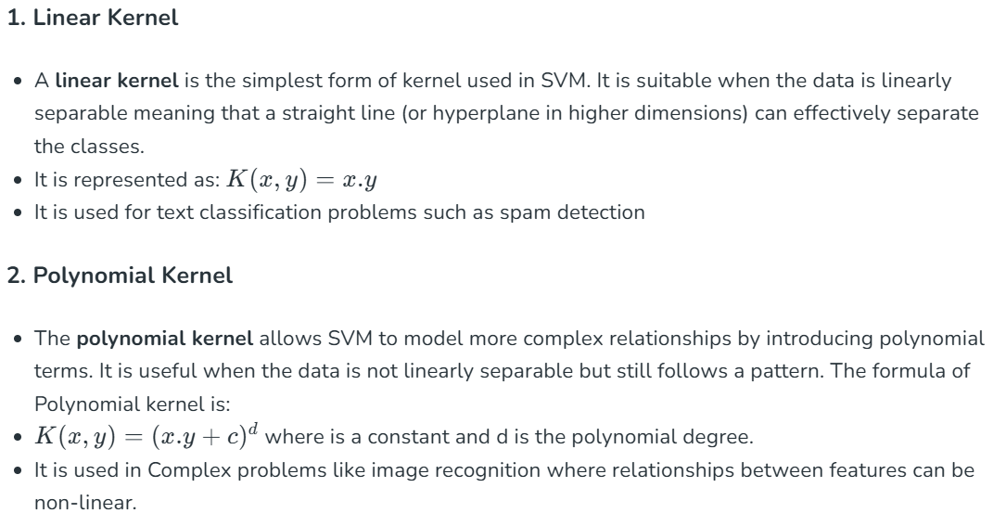
Types of Kernel functions

Slide 7
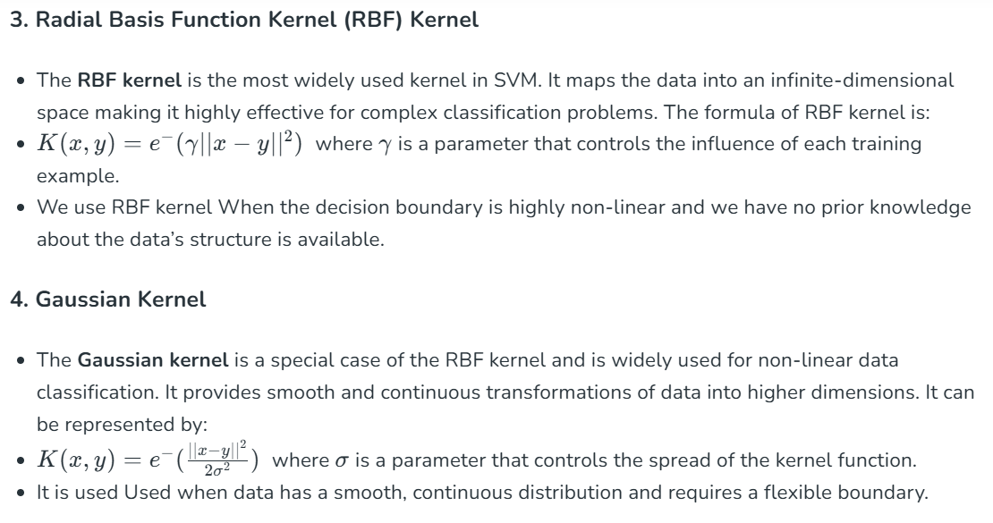

Slide 8
